Slide 1

Heart Attack Prediction
SKILL LAB PROJECT
Submitted by:
Sl no. | Name | Section | Roll no | Sic
1. | Krushna Kalyan Mohanty | B2 | 04 | 21bcsb11
2. | Swapnasagar Sahoo | B2 | 16 | 21bcsd84
3. | Tarini Prasad Nayak | B2 | 29 | 21bcsg95
4. | Priyansu sekhar Sahoo | B2 | 36 | 22bcsl41
5. | Amanjot Singh | B1 | 22 | 21bcsf07

Slide 2
CONTENTS
Introduction 03
About disease 04
Objectives 05
Dataset 06
Workflow 08
Data Preparation 09
Data Visualization 10
Data Preprocessing 14
Machine learning Models 16
Graphical Comparison 23
GUI Implementation 24
Tools used 25
References 26
Conclusion 27

Slide 3
INTRODUCTION
Cardiovascular diseases (CVDs) are the number 1 cause of death globally, taking an estimated 17.9 million lives each year, which accounts for 31% of all deaths worldwide. Four out of 5CVD deaths are due to heart attacks and strokes, and one-third of these deaths occur prematurely in people under 70 years of age.
People with cardiovascular disease or who are at high cardiovascular risk (due to the presence of one or more risk factors need early detection and management where a machine learning model can be of great help

Slide 4
ABOUT THE DISEASE
Cardiovascular diseases remain a leading cause of mortality worldwide, emphasizing the critical need for accurate and timely identification of individuals at risk.
In the era of advanced data analytics, machine learning techniques have emerged as powerful tools for predictive modeling in healthcare.
This project focuses on leveraging machine learning methodologies, specifically logistic regression and principal component analysis (PCA), for the early detection and prediction of heart disease.

Slide 5
Objectives:
· Data Understanding :
o Identify and analyze the features from the dataset that
influence heart disease risk.
· Model Development & Training:
o Experiment with different machine learning algorithms suitable for
binary classification tasks (e.g., Logistic Regression, Decision Trees,
Random Forests, SVM).
· Model Implementation:
o Interpret the trained model to understand & predicting heart disease

Slide 6
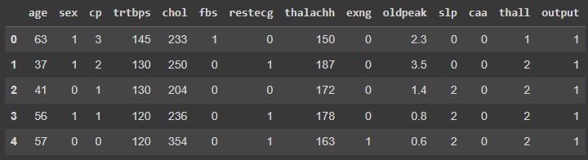
DATASET
Heart.csv
(Source: Heart Attack Analysis & Prediction Dataset (kaggle.com))
Number of rows are 303 and number of columns are 14

Slide 7
Attributes:
sex: 1:Male,0:Female
cp: Chest pain type, 0 = Typical Angina, 1 = Atypical Angina, 2 = Non-anginal Pain, 3 = Asymptomatic
trtbps: Resting blood pressure (in mm Hg)
chol: Cholesterol in mg/dl fetched via BMI sensor
fbs: (fasting blood sugar > 120 mg/dl), 1 = True, 0 = False
restecg: Resting electrocardiographic results, 0 = Normal, 1 = ST-T wave normality, 2 = Left ventricular hypertrophy
thalachh: Maximum heart rate achieved
oldpeak: Previous peak
slp: Slope
caa: Number of major vessels
thall: Thalium Stress Test result ~ (0,3)
exng: Exercise induced angina ~ 1 = Yes, 0 = No
output: Target variable(1=Heart attack,0=Not having heart attack)

Slide 8
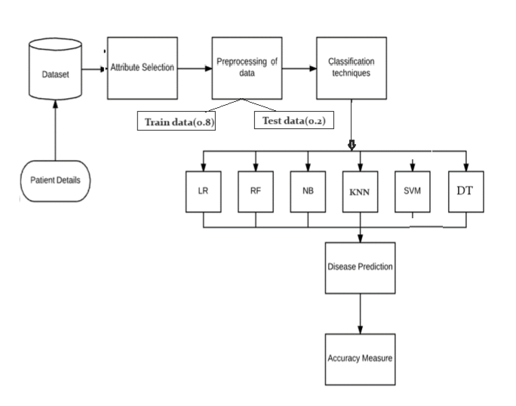
WORKFLOW

Slide 9
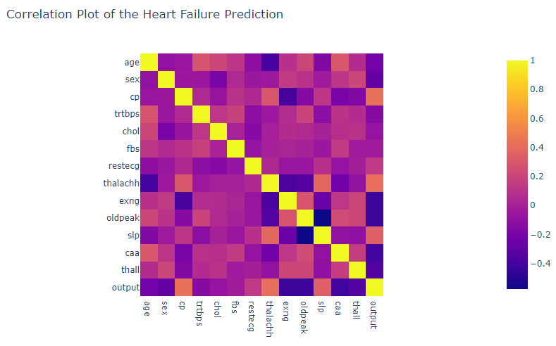
Data Prepairation
Steps:
Checking for datatypes
Checking for null values
Checking for duplicate values
Check for new shape
Correlation plot of attributes

Slide 10
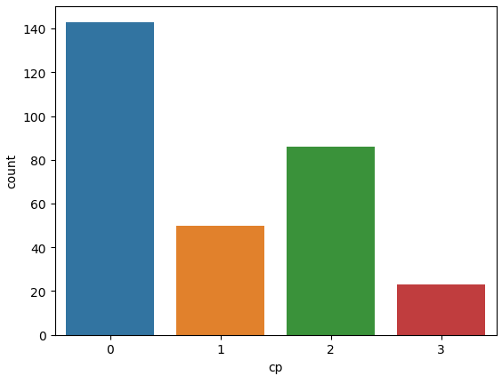
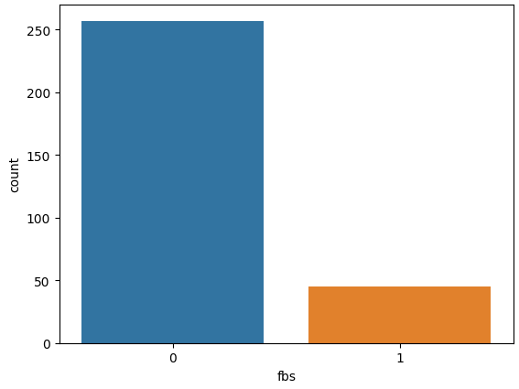
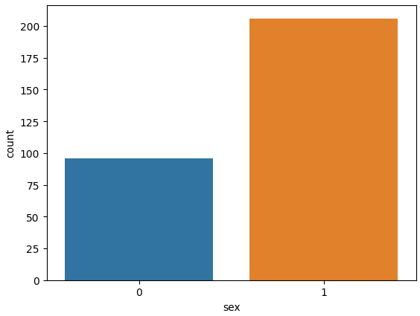
Data Visualization
Breakdown of attributes using countplot:-
Number of people having sex as
Male are 206 and Number of people
having sex as Female are 96
It can be observed people have chest pain of type 0 i.e 'Typical Angina' is the highest.
people have chest pain of type 3 i.e 'Asymptomatic' is the lowest
people with chest pain of type 0 is almost 50% of all the people.
FBS with value 0 i.e <120 is significantly higher than 1 i.e >120.

Slide 11
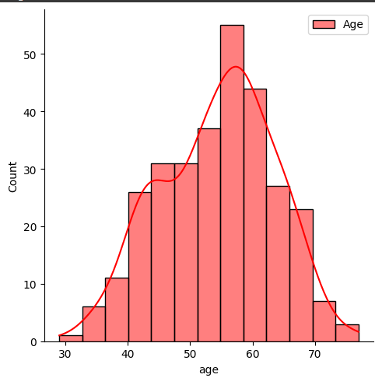
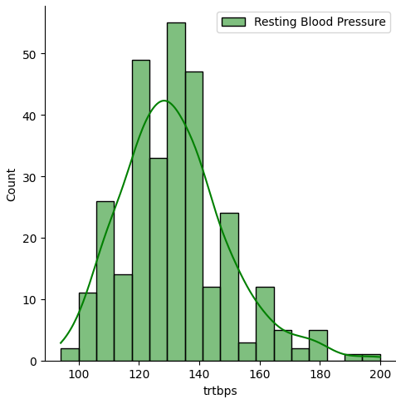
Density distribution using displot:-
For age:
For resting blood pressure:
Density distribution is highest for age group 55 to 60
Trtbs has the highest count around 130

Slide 12
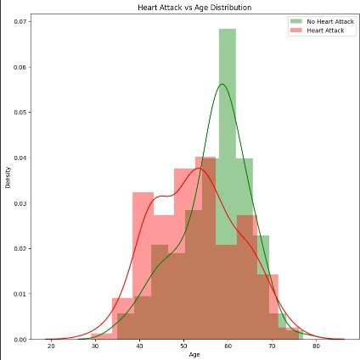
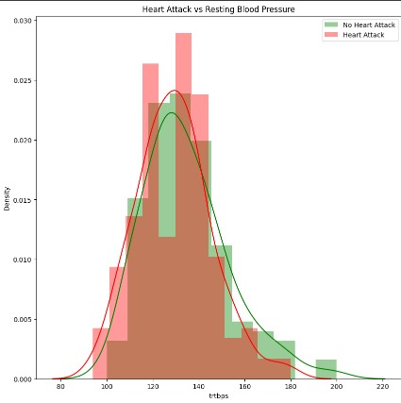
Displot: (attribute vs attribute)
Age vs Heart attack(output)
Resting blood sugar vs Heart Attack

Slide 13
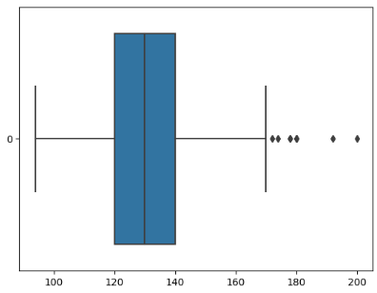
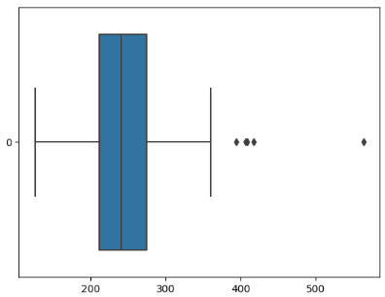
Boxplot: (to view outlier)
For cholesteol:
For Resting blood pressure:

Slide 14
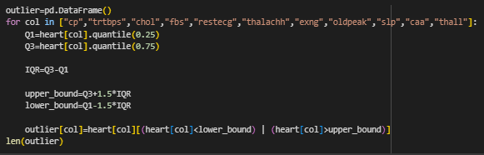
DATA PREPROCESSING
1.Calculate no of outlier ising IQL:

Slide 15


2. Splitting the dataset into training and testing data (8:2 ratio)
3. Feature Scaling using Standard Scaler

Slide 16
Machine learning models
Models:
There are 6 ML algorithms that we have used for Heart attack prediction:
A machine learning model is a computational algorithm or system that is trained on data to make predictions or decisions without being explicitly programmed for the task.
In other words, a machine learning model learns patterns and relationships within data and uses that knowledge to make predictions or decisions when presented with new, unseen data
Logistic Regression
Gaussian Naïve Bayes
SVM
Decision Tree
Random Forest
KNN

Slide 17
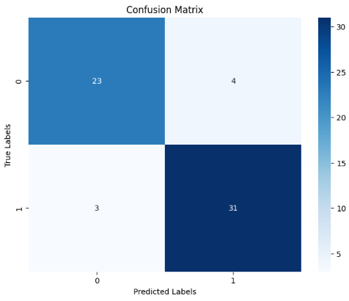


Logistic Regression
Logistic regression is a binary classification algorithm used to predict the probability of an instance belonging to a particular class. It models the relationship between independent variables and the log-odds of the dependent variable using a logistic function. The output is transformed to a probability between 0 and 1, making it suitable for classification tasks.
0: positive 1: negative

Slide 18
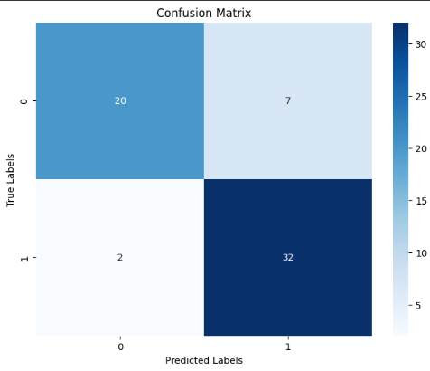


Gaussian Naïve Bayes
Gaussian Naive Bayes is a probabilistic classification algorithm based on Bayes' theorem. It assumes that features are normally distributed within each class. The model calculates the probability of a given instance belonging to each class and assigns it to the class with the highest probability. It's particularly effective for text and real-valued data.

Slide 19
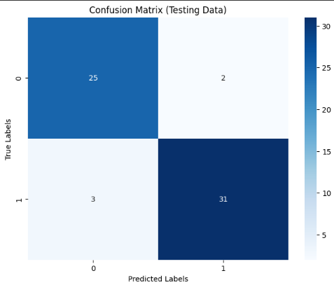


Support Vector Machine
A support vector machine (SVM) is a type of supervised learning algorithm used in to solve classification and regression tasks; SVMs are particularly good at solving binary classification problems, which require classifying the elements of a data set into two groups.
The aim of a support vector machine algorithm is to find the best possible line, or decision boundary, that separates the data points of different data classes.

Slide 20
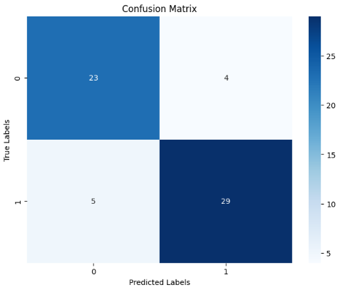


Decision Tree
A Decision Tree is a machine learning algorithm that makes decisions by recursively partitioning the data into subsets based on feature values. It selects the best features at each node to maximize information gain or minimize impurity. The process continues until a stopping criterion is met, producing a tree-like structure. During prediction, new data traverses the tree, following decision paths to reach a leaf node, which provides the final outcome or prediction.

Slide 21
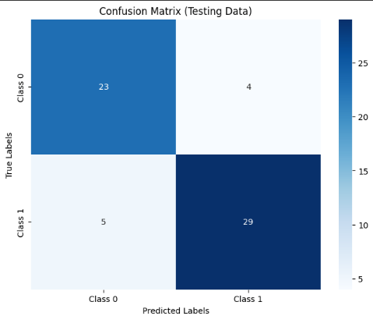


Random Forest
Random Forest is an ensemble machine learning algorithm that constructs multiple decision trees during training and outputs the mode (classification) or mean prediction (regression) of the individual trees. It works by randomly selecting subsets of features for each tree and combining their predictions. This randomness enhances robustness and reduces overfitting, resulting in a more accurate and stable model for classification or regression tasks.

Slide 22
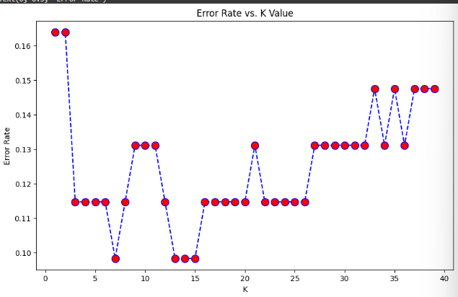
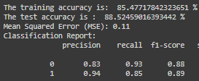
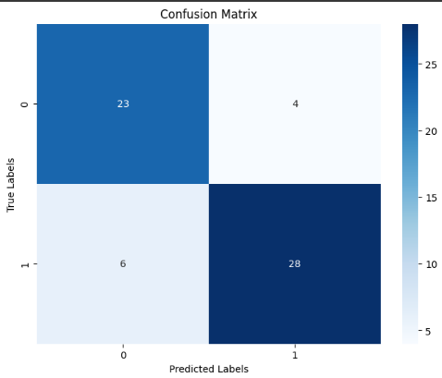
KNN
K-Nearest Neighbors (KNN) is a classification algorithm. In KNN, an object is classified by the majority class of its k nearest neighbors in the feature space. It works by calculating distances between data points and assigning a class label based on the most common class among its neighbors.
For optimising k value, we get less error at k=7

Slide 23
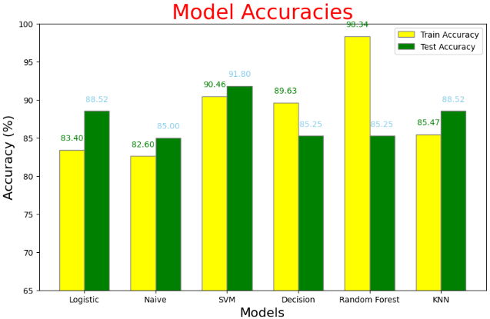
GRAPHICAL REPRESENTATION OF TRAINING AND TESTING ACCURACY OF ALL MODELS

Slide 24
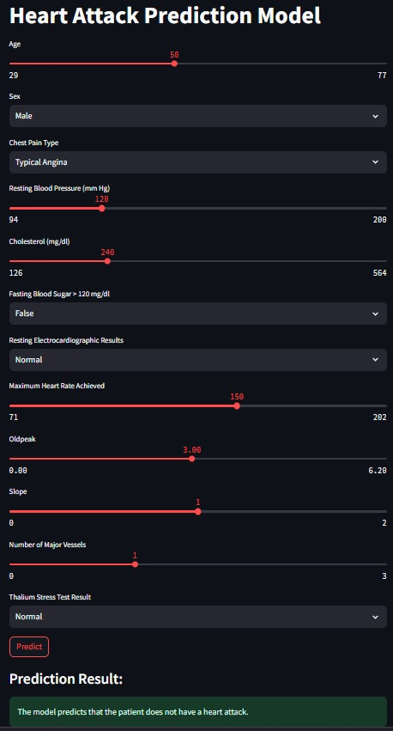
GUI Implementation
Using Streamlit

Slide 25
Tools used:
Libraries
Platforms
VS code
Colab
Seaborn
Numpy
Pandas
Matplotlib
Svc
Train_test_split
Standard Scalar
Classifiers
Plotly
Streamlit
Pickle

Slide 26
References
https://www.researchgate.net (for project support)
https://f1000research.com (for project support)
https://www.kaggle.com (for data set)
https://www.hindawi.com (for journal)
https://lucid.app (for flowchart configure)

Slide 27
Conclusion
Most of the models are performing really well.
SVM is performing the best (91.8% accuracy) for the given dataset.
The review concludes by summarizing key findings, highlighting the importance of ML in heart attack prediction, and suggesting avenues for future research. It underscores the need for collaborative efforts between researchers, clinicians, and data scientists to advance the field and improve patient outcomes.

Slide 28
Thank You

